Slide 1
Layoff Risk Classification
Extract → Learn → Predict
INFO 6105 — Final Project
Presented by: Pin-Yuan Tseng, Shirui Zhang, Yixin Mao
Date: Dec 8, 2025
Notes:
Good afternoon, everyone. We are Pin-Yuan, Shirui, and Yixin. Today we're presenting our Layoff Risk Classification project.

Slide 2
Problem Statement & Context
Tech layoffs surged significantly across 2022–2024.
  Need early risk detection for employees, HR, investors.
  Goal: Classify companies into High vs Low layoff risk.
    High Risk (1): layoff_ratio > 5% OR recent heavy layoffs.
    Low Risk (0): otherwise.
Dataset
  Raw Data: 489 companies (from Kaggle)
  Cleaned: 142 usable companies after processing
Notes:
Tech layoffs surged across 2022 to 2024, creating a need for early risk detection. Our goal is to classify companies into High Risk or Low Risk. High Risk means layoff ratio exceeds 5% or recent heavy layoffs.
We started with 489 companies from Kaggle, and after cleaning, we have 142 usable companies.

Slide 3
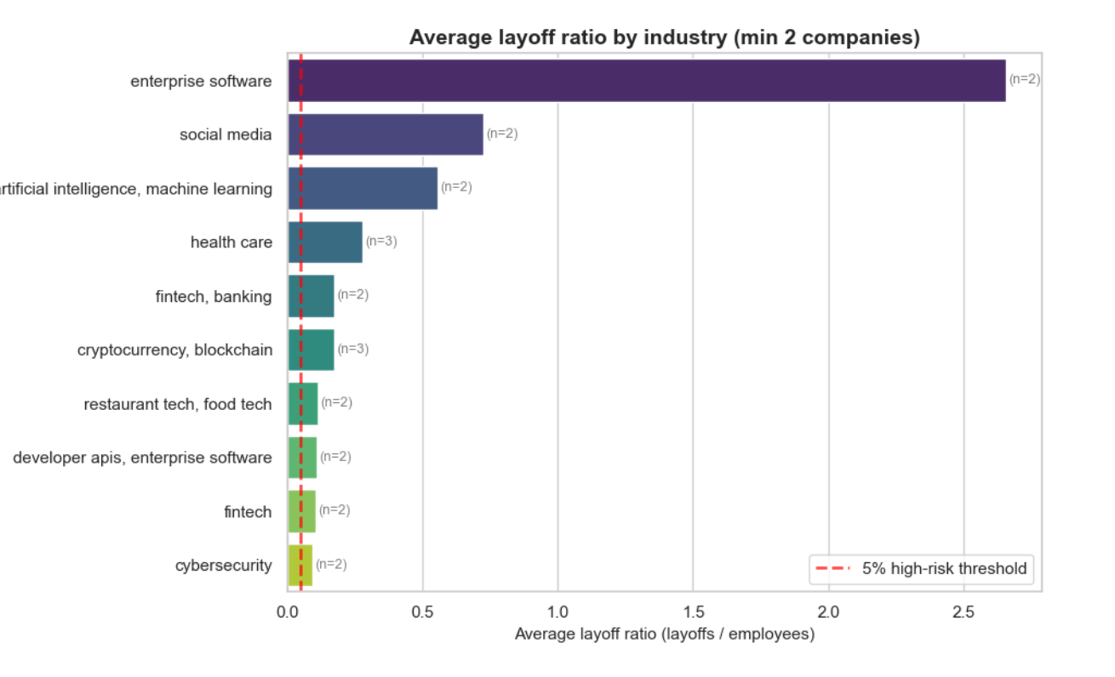
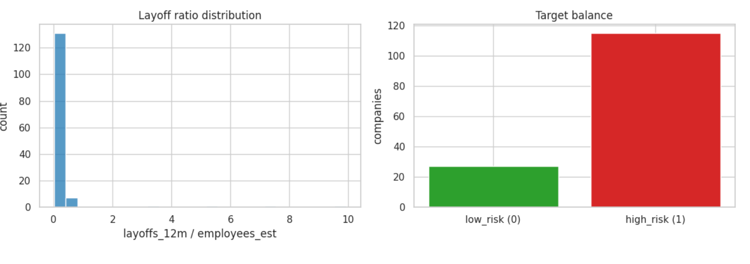
Data Extraction & EDA Insights
Layoff ratio is heavily right-skewed; most companies <0.2
Dataset is strongly imbalanced: 81% high-risk
Industry-level differences: enterprise software and social media show highest average layoff ratios, well above 5% threshold
Notes:
Our EDA revealed three key insights. First, layoff ratios are heavily right-skewed—most companies are below 0.2. Second, our dataset is strongly imbalanced with 81% high-risk companies. Third, we see clear industry-level differences. AI, analytics, and healthcare show nearly 100% high-risk rates.

Slide 4
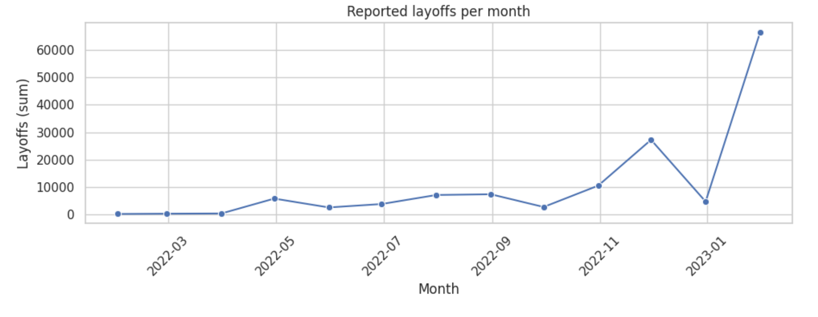
Layoff Trends Over Time
Layoff activity shows clear spikes in late 2022 and early 2023, driven by macroeconomic and tech-sector slowdowns.
Peaks are concentrated in tech and fintech companies, indicating heightened workforce risk during these periods.
Notes:
Looking at trends over time, we see dramatic spikes in late 2022 and early 2023, driven by macroeconomic factors. These peaks are concentrated in tech and fintech, validating why our classification task matters.

Slide 5
Modeling Strategy (Learn Phase)
Preprocessing
  One-hot encode categorical columns
  Train/Test split = 80/20 with stratify (due to imbalance)
  class_weight='balanced' for fairness
  Models evaluated
  Decision Tree (primary)
  Random Forest
Metrics
  Accuracy
  F1 (positive)
  Recall (positive)
  ROC-AUC
  Confusion Matrix
Notes:
For preprocessing, we one-hot encoded categorical features and used an 80/20 train-test split with stratification. We applied class_weight='balanced' for fairness.
We evaluated Decision Tree and Random Forest, measuring Accuracy, F1, Recall, ROC-AUC, and Confusion Matrix.

Slide 6
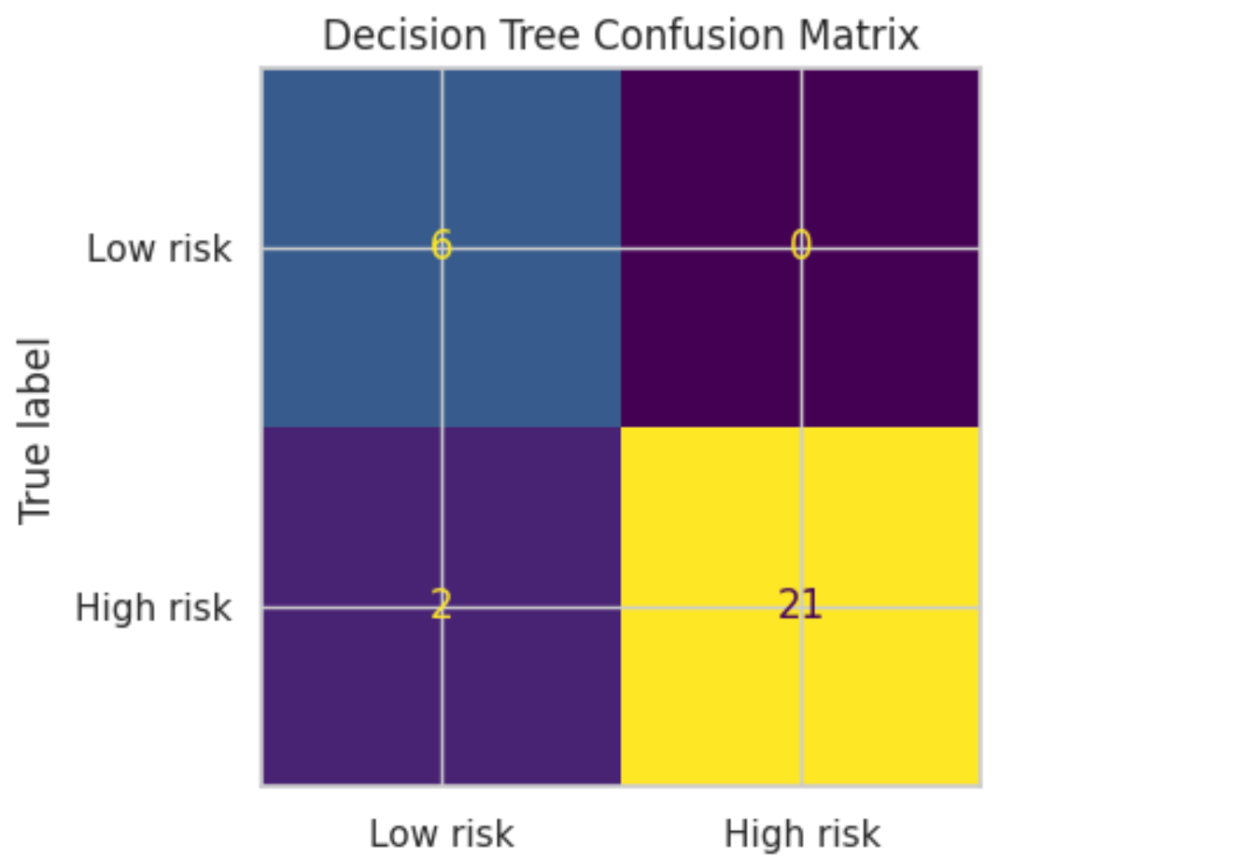
Decision Tree Results
Accuracy = 0.931 | F1 = 0.955 | Recall = 0.913 | ROC-AUC = 0.971
  False Negatives = 2 (old layoffs >1000 days)
  False Positives = 0
Error Analysis
False Negatives = 2 (Apollo, Rock Content)
  High historical layoff ratios
  But layoffs occurred >1000 days ago
  Tree down-weights old layoffs
False Positives = 0
  Very good precision & interpretability
Notes:
Our Decision Tree achieved excellent results: 93.1% accuracy, F1 of 0.955, and ROC-AUC of 0.971.
We had only 2 false negatives—Apollo and Rock Content—both with old layoffs over 1,000 days ago. The tree correctly down-weights outdated data. Zero false positives means excellent precision.

Slide 7
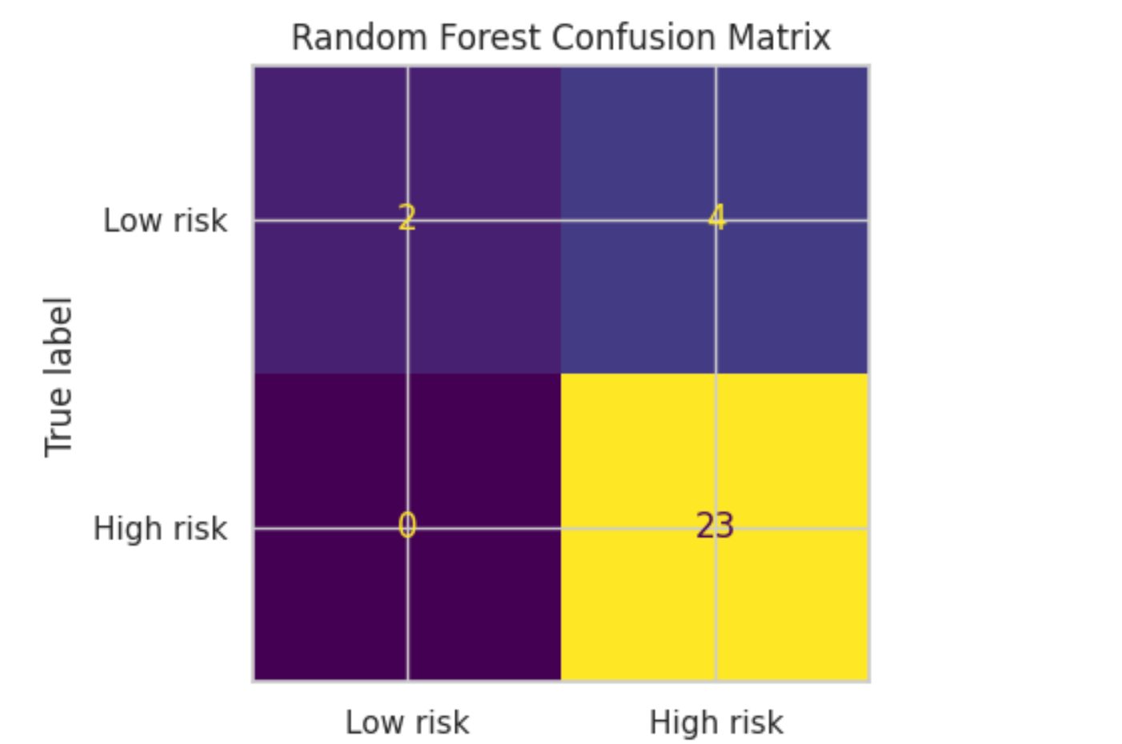
Random Forest Results
Accuracy = 0.862 | F1 = 0.920 | Recall = 1.000 | ROC-AUC = 0.928
  False Positives = 4 → overpredicts risk
Interpretation
Captures all positives (perfect recall)
But produces 4 false positives
Less accurate overall
Better for “don’t miss any risky company” use cases
Notes:
Random Forest achieved 86.2% accuracy with perfect recall of 1.0, but produced 4 false positives. It's better for "don't miss any risk" scenarios, but Decision Tree offers better balance and interpretability.

Slide 8
Prediction Demo (Predict Phase)
Using the full-dataset trained Decision Tree
• High layoff_ratio companies (≥0.07–0.10) consistently predicted as high risk
• Predictions align with industry patterns (security, blockchain, ecommerce)
• Low ratio companies (<0.04) predicted as low risk → strong precision
• Interpretability: model behavior matches decision tree split thresholds
Company | Industry | layoff_ratio | pred
addepar | fintech | 0.03 | 0
aqua security | security | 0.10 | 1
superrare | blockchain | 0.12 | 1
informatica | cloud | 0.07 | 1
bigcommerce | ecommerce | 0.12 | 1
wonder | food delivery | 0.07 | 1
citizen | surveillance | 0.027 | 0
vimeo | media | 0.12 | 1
Notes:
Here's our model in action. Companies with high ratios—like Aqua Security at 0.10, SuperRare at 0.12—are predicted as high risk. Low ratio companies like Addepar at 0.03 are predicted as low risk. Predictions align well with industry patterns and are highly interpretable.

Slide 9
Usefulness & Users
Who benefits?
  Employees: Avoid unstable companies.
  HR: Workforce planning & forecasting.
  Investors/Analysts: Stability insights.
  Policy Makers: Track sector-level layoffs.
Why it works?
  Transparent Decision Tree
  Uses only public data
  Easy to extend and deploy
Notes:
Who benefits? Employees can avoid unstable companies. HR teams can plan better. Investors get stability insights. Policy makers can track sector trends.
Why does it work? Transparent Decision Tree, public data only, and easy deployment.

Slide 10
Future Work & Improvements
More Resources
Integrate richer company data
  Financial health (revenue, growth, cash flow)
  Hiring freeze & headcount trends
  Funding events and investor signals
  News sentiment & stock volatility
Add time-series features (recent layoff spikes)
Explore advanced models (XGBoost / LightGBM / AutoML)
Fairness & Bias Reduction
  Evaluate fairness across industries and company sizes
  Mitigate industry bias via reweighting or stratified training
  Apply post-hoc calibration to avoid overestimating risk
  Enhance model transparency using SHAP / LIME
Notes:
Future improvements include integrating financial data, hiring trends, and news sentiment. We'd explore advanced models like XGBoost and add time-series features. We also want to address fairness across industries and enhance interpretability with SHAP or LIME

Slide 11
Thank you
Notes:
That concludes our presentation.

